Slide 1

UNIT - VI
Relational Database Design

Slide 2
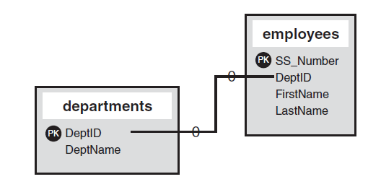
The Importance of Good Relational Database Design:
A relational database is a collection of data items organized as a set of formally-described tables from which data can be accessed in efficient manner
A good relational database design is crucial for high-performance applications
Relationship Between Two Tables

Slide 3
When designing a relational database, we have to make some decisions:
Which table to create
What columns will contain
Relationships between tables
Benefits of Relational Database Design:
Data entry, updates and deletions will be efficient.
Data retrieval, summarization and reporting will also be efficient
Since much of the information is stored in the database rather than in the application, the database is somewhat self-documenting

Slide 4
Pitfalls in Relational Database Design
Relational database design requires a “good” collection of relation schemas”.
A bad design may lead to :
– Repetition of information
– Inability to represent certain information
For Example-If we combine two schemas:
Instructor (ID, Name, Salary)
Department ( Dept_Name, Building, Budget)

Slide 5
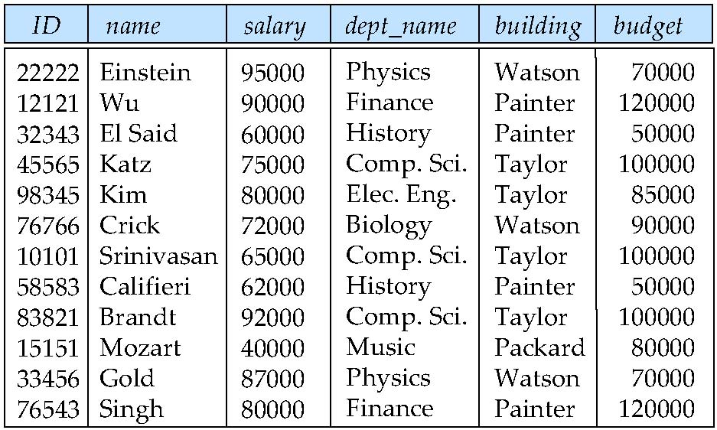
Ins_Dept
Result is repetition of information
It is difficult to update in tuples because need to update all respective tuples

Slide 6
Relational Database Design Goals
Avoid redundant data
Ensure to relationships among attributes
Checking updates for ensuring integrity constraints
To ensure designing goals, removal of duplicate records and for efficient database, we will use “Normalization”

Slide 7
Functional Dependencies
Functional dependencies play a key role in differentiating good database designs from bad database designs
A functional dependency is a type of constraint that is a generalization of the notion of key and apply on the set of legal relations
“A functional dependency is defined as a constraint between two sets of attributes in a relation from a database”

Slide 8
Given a relation R, a set of attributes X in R is said to functionally determine another attribute Y which is also in R, then it can be written as
X → Y
Iff each X value is associated with at most one Y value.
X = determinant set
Y = dependent attribute
Thus, given a tuple and the values of the attributes in X, one can determine the corresponding value of the Y attribute.

Slide 9
Employee
E
X
A
M
P
L
E
SSN | Name | Job_Type
12543 | Smith | Accountant
23145 | John | Accountant
67543 | Smith | Engineer
Here, Name is functionally dependent on SSN because an employee’s name can be uniquely determined from their SSN.
SSN Name
Determined Attributes
Determinant Set
FD’s uniquely determine the records

Slide 10
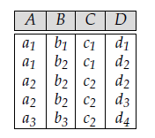
Sample Relation “R”
E
X
A
M
P
L
E
Many FD’s are satisfied in given relation R
1)
2) AD B
a1 | c1
a2 | c2
a3 | c2
a1d1 | b1
a1d2 | b2
a2d2 | b2
a2d3 | b2
a3d4 | b3
Here C is dependent on A & A must be unique
It is not satisfied

Slide 11
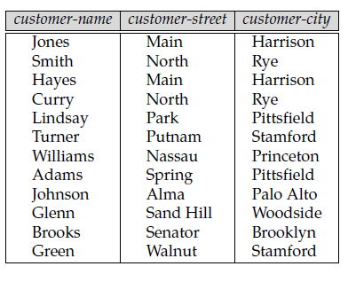
E
X
A
M
P
L
E
Customer
Find out the Fd’s of given “Customer” Schema:
Main | harrison
North | Rye
Park | pittsfield
Putnam | Stamford
Spring | pittsfield
Jones | main
Smith | North
Hayes | Main
Curry | North
Green | walnut
** But in this schema reversal FD is not satisfied

Slide 12
Armstrong’s Axioms
Developed by Armstrong in 1974
There are six rules (axioms) that all possible functional dependencies may be derived from them
These rules are basically used for finding “Closure” of functional dependency

Slide 13
Reflexivity Rule --- If X is a set of attributes and Y is a subset of X, then
X → Y holds or X → X holds
each subset of X is functionally dependent on X.
2. Augmentation Rule --- If X → Y holds and W is a set of attributes, then
WX → WY holds.
3. Transitivity Rule --- If X → Y and Y → Z holds, then X → Z holds.

Slide 14
4. Union Rule --- If X → Y and X → Z holds, then X → YZ holds.
5. Decomposition Rule --- If X → YZ holds, then so do X → Y and X → Z.
6. Pseudotransitivity Rule --- If X → Y and WY → Z hold then so does WX → Z.

Slide 15
R = (A, B, C, G, H, I) and the
set F of functional dependencies {A → B,
A → C, CG → H, CG → I, B → H}
A → H. Since A → B and B → H hold, we apply the transitivity rule. Observe that it was much easier to use Armstrong’s axioms to show that A → H holds than it was to argue directly from the definitions
CG → HI . Since CG → H and CG → I , the union rule implies that CG → HI .
AG → I. Since A → C and CG → I, the pseudotransitivity rule implies that AG → I holds.
Another way of finding that AG → I holds is as follows. We use the augmentation rule on A → C to infer AG → CG. Applying the transitivity rule to this dependency and CG → I, we infer AG → I.
E
X
A
M
P
L
E

Slide 16
Closure of Attribute Sets
Functional dependencies are “logically implied” by F
Since Armstrong’s rules (Inferences) are simple for finding FD’s but possibility of mistakes and consume lots of time
More formally, if F is functional dependencies of a relation R and identify more dependencies that also satisfy that relation R is called “Closure of FD’s
Main use of closure is to find super key/ candidate keys of given relation
Use closure to Identify all FD’s of given FD’s

Slide 17
Steps to Compute Closure Sets
Compute closure of all FDs as given in left hand side
2. Apply augmentation and Reflexive rule
3. Add the resulting functional dependencies to F ⁺
4. Repeat steps 1, 2 ,3 as many times to cover all FD’s
5. Stop the procedure if no more closure are identified

Slide 18
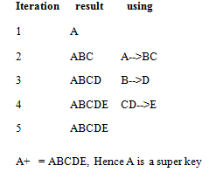
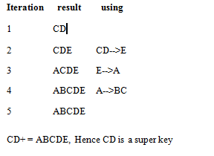
Compute the closure for relational schema R={A,B,C,D,E}
FD’S: A-->BC CD-->E B-->D E-->A
Solution:
E
X
A
M
P
L
E
Closure for CD
Closure for A
** Super key which covers all the attributes of a relation

Slide 19
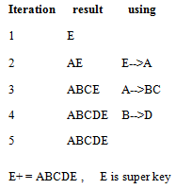
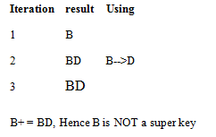
Closure of B
Closure of E
A, CD, E are Super Keys of given Relation R
Questions can be formed like “Define no. of keys in given relation”

Slide 20
1. R= (A, B, C, D, E, G)
A→ BC
BC→ DE
AEG → G
Compute AC +
A→ B
B→ D
E→ FG
Does E→ D exist or not?
Closure of A union C
1. ABC
ABCDE
AC+ = ABCDE
E
X
A
M
P
L
E
Closure of E
E→ FG
EFG
E→ D does not exist

Slide 21
Canonical Cover
An update on the relation, the database system must ensure that the update does not violate any functional dependencies, that is, all the functional dependencies in F are satisfied in the new database state.
The system must roll back the update if it violates any functional dependencies in the set F.
We can reduce the effort spent in checking for violations by finding out the canonical cover of given set which is extraneous attributes
Notes:
Ven

Slide 22
Extraneous Attributes
Consider F, and a functional dependency, A → B.
“Extraneous”: Are there any attributes in A or B that can be safely removed ? “ Without changing the constraints implied by F
Example: Given F = {A → C, AB → CD}
C is extraneous in AB → CD since AB → C can be inferred even after deleting C
Intuitively, a canonical cover of F is a “minimal set of functional dependencies equivalent to F, having no redundant dependencies or redundant parts of dependencies

Slide 23
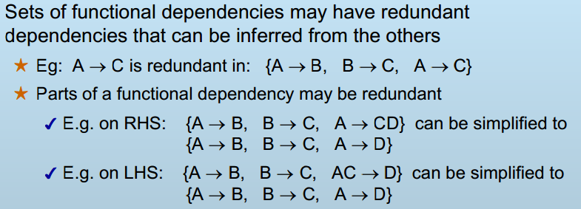

Slide 24
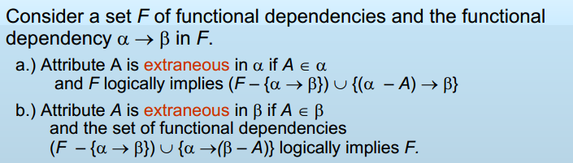
Formal Representation of Removing Extraneous attributes/Computing Canonical Cover
(LHS)
(RHS)
Step 1: Decompose all FDs in standard form
Replace each FD X → A1A2…Ak in F with
X→A1, X→A2, …, X→Ak

Slide 25
Step 2: Eliminate unnecessary attributes from LHS/RHS
For every FD X → A in F, check if the closure of a subset of X determines A. If so, remove redundant attribute(s) from X
Step 3: Remove redundant FD(s)
For every FD X → A in F
Remove X → A from F, and Compute X+
If A ∈ X+, then X → A is redundant. Hence, we remove the FD X → A from F
Step 4: Make LHS/RHS of FDs unique
Replace X→A1, X→A2, …, X→Ak with X → A1A2…Ak

Slide 26
Computing Canonical Cover
E
X
A
M
P
L
E
1. Given F = {A → C, AB → C }
Compute A+ and AB+
A is extraneous in AB → C because
{A → C, AB → C} is equivalent to
{A → C, B → C }
Given F = {A → C, AB → CD}
compute closure
C is extraneous in AB → CD because {A → C, AB → CD} is equivalent to
{A → C, AB → D}

Slide 27
Decomposition
Decompose a relation schema that has many attributes into several schemas with fewer attributes
Let R be a relation schema
A set of relation schemas { R1, R2,…, Rn } is a decomposition of R if
R = R1 U R2 U …..U Rn
each Ri is a subset of R ( for i = 1,2…,n)
But careless decomposition may lead to bad form of a design

Slide 28
For relation R(x,y,z) there can be 2 subsets:
R1(x,z) and R2(y,z)
If we union R1 and R2, we get R
R = R1 U R2
E
X
A
M
P
L
E
Decomposition
Loss Less Join Decomposition
Lossy Join Decomposition

Slide 29
Lossy Decomposition
Model Name | Price | Category
a11 | 100 | Canon
s20 | 200 | Nikon
a70 | 150 | Canon
R
R1
R2
Model Name | Category
a11 | Canon
s20 | Nikon
a70 | Canon
Price | Category
100 | Canon
200 | Nikon
150 | Canon
Model name→ Category
Price → category

Slide 30
Model Name | Price | Category
a11 | 100 | Canon
a11 | 150 | Canon
s20 | 200 | Nikon
a70 | 100 | Canon
a70 | 150 | Canon
R1 U R2
Model Name | Price | Category
a11 | 100 | Canon
s20 | 200 | Nikon
a70 | 150 | Canon
But main R is

Slide 31
Lossy Decomposition
In previous example, additional tuples are obtained along with original tuples
Although there are more tuples, this leads to less information
Due to the loss of information, decomposition for previous example is called lossy decomposition or lossy-join decomposition

Slide 32
Lossy Decomposition
T
Employee | Project | Branch
Brown | Mars | L.A.
Green | Jupiter | San Jose
Green | Venus | San Jose
Hoskins | Saturn | San Jose
Hoskins | Venus | San Jose
E
X
A
M
P
L
E
Functional dependencies:
Employee Branch,
Project Branch

Slide 33
T1
T2
Employee | Branch
Brown | L.A
Green | San Jose
Hoskins | San Jose
Project | Branch
Mars | L.A.
Jupiter | San Jose
Saturn | San Jose
Venus | San Jose
Employee | Project | Branch
Brown | Mars | L.A.
Green | Jupiter | San Jose
Green | Venus | San Jose
Hoskins | Saturn | San Jose
Hoskins | Venus | San Jose
Green | Saturn | San Jose
Hoskins | Jupiter | San Jose
T1 U T2
Loss info

Slide 34
Lossless Decomposition
A decomposition {R1, R2,…, Rn} of a relation R is called a lossless decomposition for R if the join of R1, R2,…, Rn produces exactly the relation R.
A decomposition is lossless if we can recover:
R(A, B, C)
Decompose
R1(A, B) R2(A, C)
Recover
R’(A, B, C)
Thus, R’ = R

Slide 35
E
X
A
M
P
L
E
Model Name | Price | Category
a11 | 100 | Canon
s20 | 200 | Nikon
a70 | 150 | Canon
R
R1
R2
Model Name | Price
a11 | 100
s20 | 200
a70 | 150
Model Name | Category
a11 | Canon
s20 | Nikon
a70 | Canon

Slide 36
Lossless Decomposition Property
R : relation
F : set of functional dependencies on R
R1,R2 : decomposition of R
Decomposition is lossles if :
R1 ∩ R2 → R1, that is: all attributes common to both R1 and R2 functionally determine ALL the attributes in R1
OR
R1 ∩ R2 → R2, that is: all attributes common to both R1 and R2 functionally determine ALL the attributes in R2

Slide 37
R = (A, B, C, D, E)
R1 = (A, B, C) R2 = (A, D, E)
The set of functional dependencies:
A → BC, CD → E, B → D, E → A
1. R1 ∩ R2 = A;
2. Compute A+
(A → BC)
(A → ABC)
A→ ABCD
(A → ABCDE)
Here A contains all attributes which follows R1 and R2 relation
(R1 ∩ R2 → R1) , (R1 ∩ R2 → R2 ) Lossless-join decomposition
E
X
A
M
P
L
E

Slide 38
R = (A, B, C, D, E)
R1 = (A, B, C) R2 = (A, D, E)
The set of functional dependencies is:
A → BC, E → A
1. R1 ∩ R2 = A;
2. Compute A+
(A → BC)
(A → ABC)
Here A contains all attributes which follows R1 relation
(R1 ∩ R2 → R1) this is a lossless-join decomposition
E
X
A
M
P
L
E

Slide 39
Dependency Preservation
Getting lossless decomposition is necessary so we need to get relations which contains all existing functional dependency or preserve dependencies
A decomposition D = {R₁, R₂, ..., R_{n}} of R is dependency-preserving with respect to F if the union of the projections of F on each R_{i} in D is equivalent to F; that is if (F₁ ∪ F₂ ∪ … ∪ F_{n} )⁺ = F ⁺

Slide 40
Example of Dependency Preservation
R(A B C D)
FD₁: A ➔ B
FD₂: B ➔ C
FD₃: C ➔ D
Decomposition: R₁(A B C) R₂(C D)

Slide 41
FD₁: A ➔ B
FD₂: B ➔ C
FD₃: C ➔ D
R₁( A B C )
FD₁
FD₂

Slide 42
FD₁: A ➔ B
FD₂: B ➔ C
FD₃: C ➔ D
R₂( C D )
FD₃

Slide 43
FD₁: A ➔ B
FD₂: B ➔ C
FD₃: C ➔ D
R₁( A B C ) R₂( C D )
FD₁
FD₃
FD₂
Has all 3 functional dependencies!
Therefore, it’s preserving the dependencies

Slide 44
Example of Non-Dependency Preservation
R(A B C D)
FD₁: A ➔ B
FD₂: B ➔ C
FD₃: C ➔ D
Decomposition: R₁(A C D) R₂(B C)

Slide 45
FD₁: A ➔ B
FD₂: B ➔ C
FD₃: C ➔ D
R₁( A C D )
FD₃

Slide 46
FD₁: A ➔ B
FD₂: B ➔ C
FD₃: C ➔ D
R₂( B C )
FD₂

Slide 47
FD₁: A ➔ B
FD₂: B ➔ C
FD₃: C ➔ D
R₁( A C D ) R₂( B C )
FD₃
FD₂
Does not support FD₁: A => B
Therefore, it does not preserve the dependencies

Slide 48
More Example
R(A B C D E)
FD₁: A ➔ B
FD₂: BC ➔ D
Decomposition: R₁(A C E) R₂(B C D)
R₃(A B)

Slide 49
FD₁: A ➔ B
FD₂: BC ➔ D
R₁( A C E )
No Dependencies

Slide 50
FD₁: A ➔ B
FD₂: BC ➔ D
R₂( B C D )
FD₂

Slide 51
FD₁: A ➔ B
FD₂: BC ➔ D
R₃( A B )
FD₁

Slide 52
FD₁: A ➔ B
FD₂: BC ➔ D
R₁( A C E ) R₂( B C D )
FD₂
R₃( A B )
FD₁
Has all 2 functional dependencies!
Therefore, it’s preserving the dependencies

Slide 53
Types of FD’s
Partial FD 2) Transitive FD 3) Fully Functional FD
Partial FD:
All non-key (non-prime) attributes should be dependent on primary key (prime) attributes
but if non-key attribute is dependent on the part of the primary key so it is called partial FD.
Example: R(ABCD)
AB→ CD , B → D
Prime Attributes
Non-Prime Attribute
Partial FD

Slide 54
Transitive FD
It follows Transitive relation
If there is relationships among non-key attributes
NON-KEY → NON-KEY
Example:
R(ABCD)
AB→ C
C→D
B→ C
Transitivity
Partial

Slide 55
Fully Functional Dependency
If dependency is the form of
X → Y
is considered as FFD if removal of an attribute from X, makes X→Y invalid
Trivial Functional Dependency
If X→Y then Y is a subset of X
(ssn, name)→ name (trivial FD)
(ssn,name)→ marks (non-trivial FD)

Slide 56
Normalization
Normalization refers to the process of structuring data in order to minimize duplicity and inconsistency.
it is a step by step decomposition of relation which is lossless
The sets of rules used in normalization are called normal forms.
If database design follows the first set of rules, it’s considered in the first normal form.
If the first three sets of rules of normalization are followed, database is said to be in the
third normal form and so on.

Slide 57
Goals of normalization
ensures data integrity
prevents redundancy data
to avoid data anomaly:
update anomaly
insertion anomaly
deletion anomaly

Slide 58
First Normal Form
Eliminating redundancy is the first step in normalization
The rules for the first normal form are as follows:
Each table has a primary key: minimal set of attributes which can uniquely identify a record
The values in each column of a table are atomic (No multi-value attributes allowed).
There are no repeating groups: two columns do not store similar information in the same table.

Slide 59
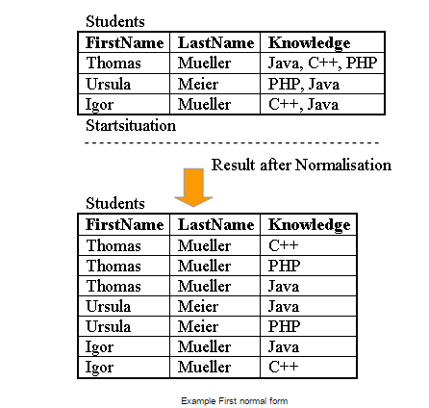

Slide 60
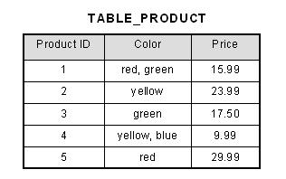
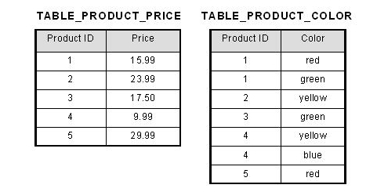
Unnormalized Data
Normalized Data

Slide 61
Second Normal Form
A relation R is in second normal form (2NF) iff
It is in 1NF and
every non-key attribute is fully dependent on the primary key
In a table, if attribute B is functionally dependent on A, but is not functionally dependent on a proper subset of A, then B is considered fully functional dependent on A. Hence, in a 2NF table, all non-key attributes cannot be dependent on a subset of the primary key. Note that if the primary key is not a composite key, all non-key attributes are always fully functional dependent on the primary key.

Slide 62
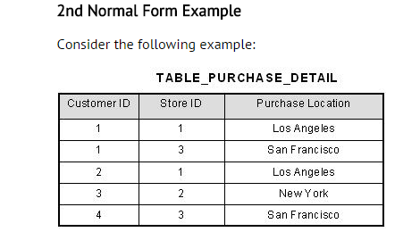
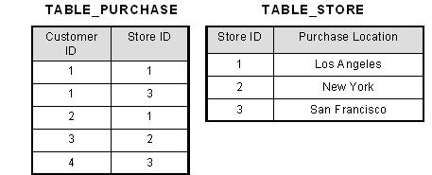
(customer_Id, Store_id)-→ purchase_location
Store_id→ purchase-location
Unnormalized Data
Normalized Data
Now, in the table [TABLE_STORE], the column [Purchase Location] is fully dependent on the primary key of that table, which is [Store ID].

Slide 63
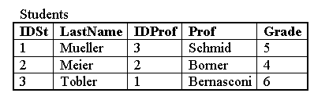
Example: Student (IDSt, StudentName, IDProf, ProfessorName, Grade)
It is in 1NF: all attributes are having single values

Slide 64
The table in this example is in first normal form (1NF) since all attributes are single valued. But it is not yet in 2NF.
If student 1 leaves university and the tuple is deleted, then we loose all information about professor, since this attribute is fully functional dependent on the primary key IDSt.
To solve this problem, we must create a new table Professor with the attribute Professor (the name) and the key IDProf.
The third table Grade is necessary for combining the two relations Student and Professor and to manage the grades. Besides the grade it contains only the two IDs of the student and the professor. If now a student is deleted, we do not loose the information about the professor.

Slide 65
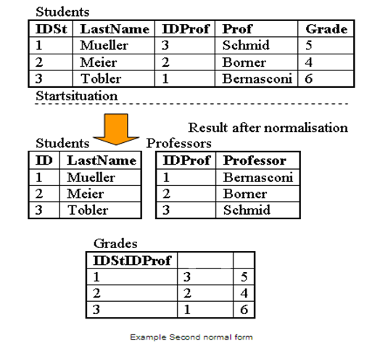
The following FD’s exist
IDProf --> ProfessorName
IDSt --> StudentName
IDSt, IDProf --> Grade
IDProf
Grade

Slide 66
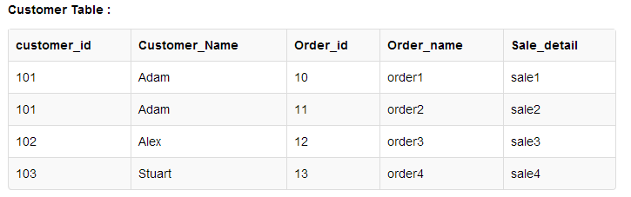
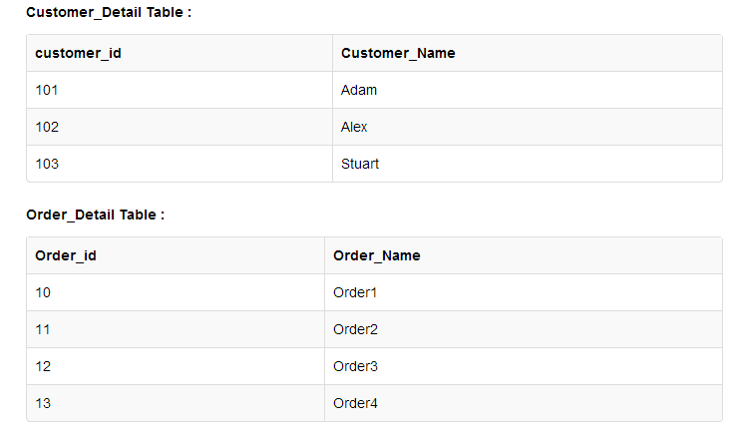
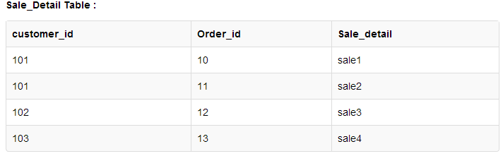
Another Example of 2NF
After Normalization

Slide 67
Third Normal Form
It is in 1NF and 2NF
All non prime fields are dependent on the primary key (No Transitive FD)
A relation may have more than one candidate key or composite key
Example:
1) AB→ C
E→ D
AC→B
D→E
B→F
HG→F
Not in 3NF due to Transitive Dependency

Slide 68
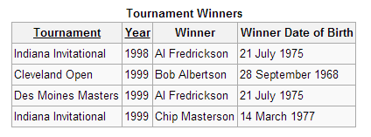
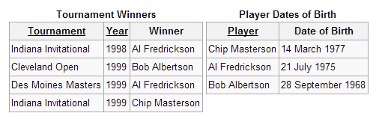
Given FD’s
Tournament, year→ winner
winner → winner DOB
It is not in 3NF due to transitive dependency
After Normalization
Tournament, year → winner
Player → DOB

Slide 69
Emp
Emp_id | Ename | Salary | Dept_id | Dname
10 | John | 2000 | C1 | IT
12 | Marry | 2000 | E1 | HR
15 | John | 3000 | C1 | IT
Emp_id-> ename, salary
Empid-> dept-id
Dept_id->Dname
Not in 3NF due to transitivity rule
EmpID | Ename | Salary | Dept_id
10 | John | 2000 | C1
12 | Marry | 2000 | E1
15 | John | 3000 | C1
Dept_id | Dname
C1 | IT
E1 | HR

Slide 70
BCNF - Boyce-Codd Normal Form
When a relation has more than one overlapping candidate keys
Example: R( A, B, C, D, E)
AC→B, CG→F, D→E, C→FD, G→A
Here AC, CG are candidate keys but overlapped so BCNF
Example: R(a,b,c,d) a,c -> b d -> b
These candidate keys are not overlapped so given relation is in 3NF but not in BCNF
Overlapping Candidate Keys

Slide 71
BCNF Rules
It should be 1,2,3 NF
A relational schema R is in Boyce–Codd normal form if and only if for every one of its dependencies X → Y, at least one of the following conditions hold
X → Y is a trivial functional dependency
(Y ⊆ X)
X is a superkey for schema R

Slide 72
R (A, B, C , D)
AB→ C
B→ DA
A→ C B
Here all L.H.S are super key so it is in BCNF
R (A, B, C , D)
AB→ C
B→ DA
Here all L.H.S are super key so it is in BCNF

Slide 73
Multivalued Dependency
Multivalued dependencies are referred to as tuple generating dependencies
Let R be a relation schema and let α ⊆ R and β ⊆ R. The multivalued dependency
α →→ β
Example: A person can have more than one telephone no. so telephone no is multivalued
From the definition of multivalued dependency, we can derive the following rule:
If α → β, then α →→ β.
In other words, every functional dependency is also a multivalued dependency

Slide 74
Multivalued Dependency
Anna
Smith
John
Jones
Lila
Cooper
Elsa
Chris
Employee (X)
Dependent (Y)
Employee Name
Dependent
Smith
Anna
Smith
John

Slide 75
Fourth Normal Form
A relation schema R is in fourth normal form (4NF) with respect to a set D of functional and multivalued dependencies if, for all multivalued dependencies in D+
of the form α →→ β, where α ⊆ R and β ⊆ R,
at least one of the following holds:
• α →→ β is a trivial multivalued dependency.
• α is a superkey for schema R
Note that the definition of 4NF differs from the definition of BCNF in only the use of multivalued dependencies instead of functional dependencies. Every 4NF schema is in BCNF.

Slide 76
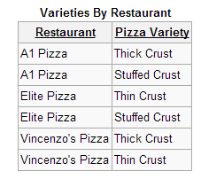




Slide 77
Fifth Normal Form
Fifth normal form (5NF), also known as project-join normal form (PJ/NF) is a level of database normalization designed to reduce redundancy in relational databases
A table is said to be in the 5NF if and only if every join dependency in it is implied by the candidate keys
A join dependency {A, B, … Z} on R is implied by the candidate key(s) of R if and only if each of A, B, …, Z is a superkey for R
Fifth normal form follows the rule upto 4th normal form

Slide 78


